Slide 1

Developed By:
Hari Shankaran
Karthika Varshini
Naveen Thiyagasundaram
Nikitha Pethakamsetty
Subhadevi Karthikeyan
Thamaraipriya Madhaiyan

Slide 2

Overview
Finance Management System
EMI Without Interest
Document Verification
Purchase Gold, Diamond, Platinum - EMI Cards
Easy Product Purchase
Admin Backend Control
Affordable Shopping Experience

Slide 3
Problem Statement
EMI interest is too high.
Traditional systems make purchases expensive.
No credit history blocks low-income users.
Financing isn’t easy or affordable.
Needs and affordability don’t align well.
Lack of Flexibility during Income Fluctuations
Confusing EMI breakdown

Slide 4
Product Objectives
Offer No-Cost EMI Options
EMI Cards Without Credit Checks
Simple, Accessible Product Purchasing
Secure and Verified Transactions using Razor Pay
Fast Registration and Approval Process
Revenue via Fees
Promote Inclusive Financial Access

Slide 5
Technologies Used
Backend
ASP.NET MVC – DTO, View, Controller architecture
ASP.NET Web API – JSON communication
Data Access
ADO.NET – Direct DB connectivity (Sql Connection)
SQL – Stores tables
Libraries & Tools
Newtonsoft.Json – JSON handling
Razor pay .NET SDK – Payment gateway integration
Bootstrap – Responsive UI
jQuery – AJAX & validations
Data Annotations – Model validations
System.mails - For Mails

Slide 6
System Overview
Register New User
Explore Products
Purchase EMI Cards
Upload Documents for Admin approval
Admin Approves / Rejects
Order Product
Payment through UPI/No cost EMI card
End Transaction, EMI Begins

Slide 7
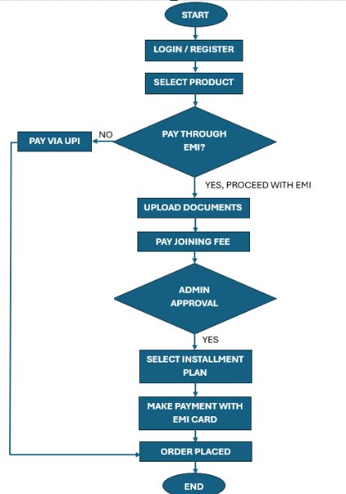
User Journey

Slide 8
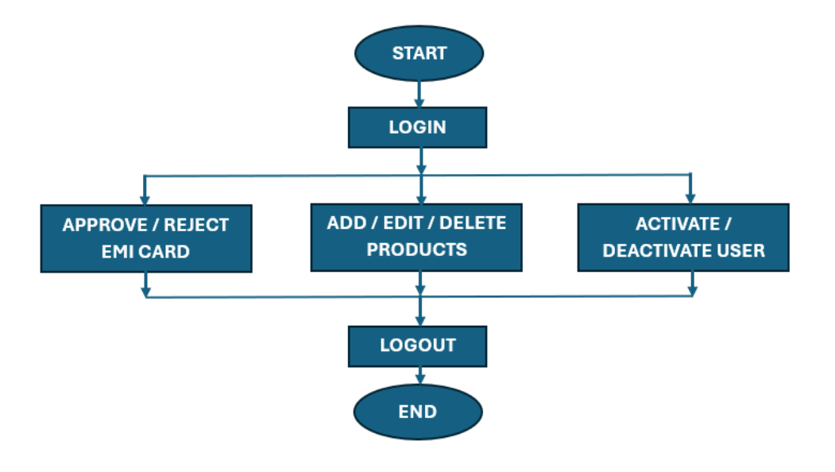
Admin Journey

Slide 9
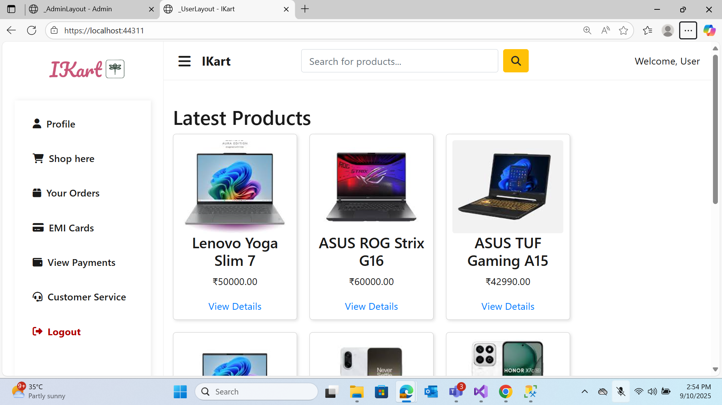
User Page

Slide 10
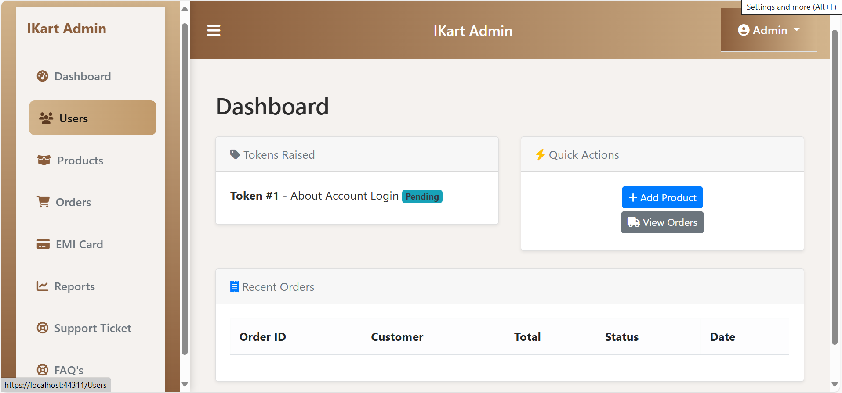
Admin Page

Slide 11
Challenges and Solutions
Card Limit Management : EMI cards are issued with predefined spending limits. This helps users stay within budget and maintain predictable expenses.
Document Verification: Users upload documents during registration. Admins verify them manually through a secure backend to ensure authenticity.
User Trust: Clear terms, transparent EMI schedules, and secure payments build confidence. These features reduce hesitation and encourage adoption.

Slide 12
Other Important Key Feature
Support Tickets for Customer Help
Admin approval for EMI card to ensure authenticity
Unified report dashboard for admin to view EMI cards, users & orders.
FAQ Explains most asked question on Products
OTP Secures User Registration Flow
Razor pay Enables Seamless Secure Payments

Slide 13

Thank you

